Slide 1
Asynchronous programming. Thread Synchronization Primitives

Slide 2
Table of content
Lock
Rlock
Semaphore
Event
Condition
Threads and Queues

Slide 3
Synchronization Options
In my experience, there is often a lot of confusion concerning the intended use of the various synchronization objects
Maybe because this is where most students "space out" in their operating system course (well, yes actually)
Anyways, let's take a little tour

Slide 4
Mutex Locks
Mutual Exclusion Lock
m = threading.Lock()
Probably the most commonly used synchronization primitive
Primarily used to synchronize threads so that only one thread can make modifications to shared data at any given time

Slide 5
Mutex Locks
There are two basic operations
m.acquire() # Acquire the lock m.release() # Release the lock • Only one thread can successfully acquire the lock at any given time • If another thread tries to acquire the lock when its already in use, it gets blocked until the lock is released

Slide 6
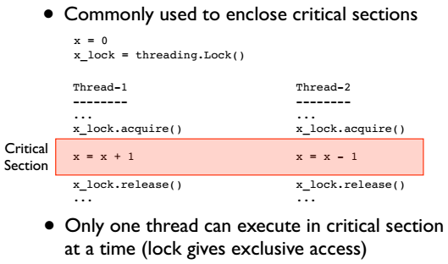
Using a Mutex Locks

Slide 7
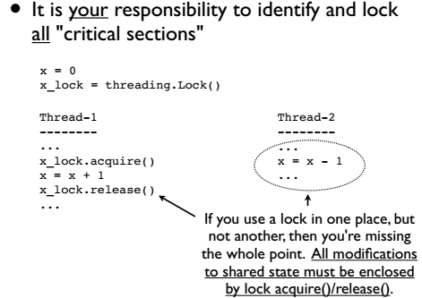
Using a Mutex Locks

Slide 8
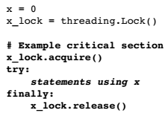
Lock Management
Acquired locks must always be released
However, it gets evil with exceptions and other non-linear forms of control-flow
Always try to follow this prototype:

Slide 9
Lock Management
Acquired locks must always be released
However, it gets evil with exceptions and other non-linear forms of control-flow
Always try to follow this prototype:
Notes:
Python 2.6/3.0 has an improved mechanism for dealing with locks and critical sections x = 0 x_lock = threading.Lock() # Critical section
with x_lock: statements using x • This automatically acquires the lock and releases it when control enters/exits the associated block of statements

Slide 10
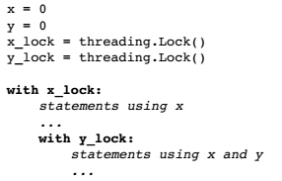
Lock Management. Deadlock
Don't write code that acquires more than one mutex lock at a time
Notes:
This almost invariably ends up creating a program that mysteriously deadlocks
(even more fun to debug than a race condition)

Slide 11
RLock
Reentrant Mutex Lock
m = threading.RLock() # Create a lock m.acquire() # Acquire the lock m.release() # Release the lock
Similar to a normal lock except that it can be reacquired multiple times by the same thread
However, each acquire() must have a release()
Common use : Code-based locking (where you're locking function/method execution as opposed to data access)

Slide 12
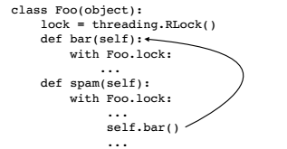
RLock
Implementing a kind of "monitor" object
Only one thread is allowed to execute methods in the class at any given time
However, methods can call other methods that are holding the lock (in the same thread)

Slide 13
Semaphores
A counter-based synchronization primitive
m = threding.Semaphore(n) # Create a semaphore m.acquire() # Acquire m.release() # Release
acquire() - Waits if the count is 0, otherwise decrements the count and continues
release() - Increments the count and signals waiting threads (if any)
Unlike locks, acquire()/release() can be called in any order and by any thread

Slide 14
Semaphore Uses
Resource control. You can limit the number of threads performing certain operations. For example, performing database queries, making network connections, etc. • Signaling. Semaphores can be used to send "signals" between threads. For example, having one thread wake up another thread.

Slide 15
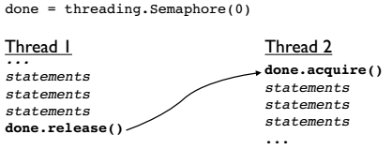
Semaphore. Resource Control
Using a semaphore to signal
Here, acquire() and release() occur in different threads and in a different order Often used with producer-consumer problems

Slide 16
Events
Event Objects
e = threading.Event() e.isSet() # Return True if event set e.set() # Set event e.clear() # Clear event e.wait() # Wait for event
This can be used to have one or more threads wait for something to occur
Setting an event will unblock all waiting threads simultaneously (if any)
Common use : barriers, notification

Slide 17
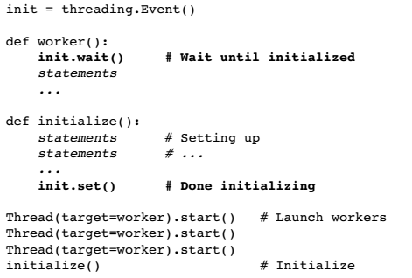
Events
Using an event to ensure proper initialization

Slide 18
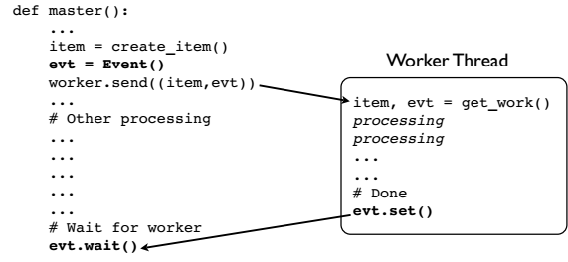
Events
Using an event to signal "completion"
Might use for asynchronous processing, etc

Slide 19
Condition Variables
Condition Objects
cv = threading.Condition([lock]) cv.acquire() # Acquire the underlying lock cv.release() # Release the underlying lock cv.wait() # Wait for condition cv.notify() # Signal that a condition holds cv.notifyAll() # Signal all threads waiting
A combination of locking/signaling
Lock is used to protect code that establishes some sort of "condition" (e.g., data available)
Signal is used to notify other threads that a "condition" has changed state

Slide 20
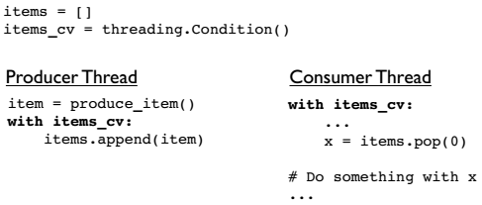
Condition Variables
Common Use : Producer/Consumer patterns
First, you use the locking part of a CV synchronize access to shared data (items)

Slide 21
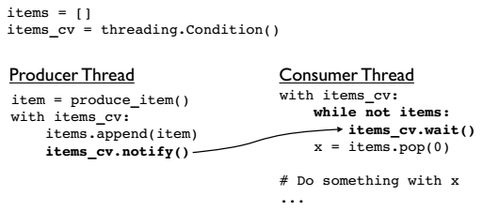
Condition Variables
Common Use : Producer/Consumer patterns
Next you add signaling and waiting
Here, the producer signals the consumer that it put data into the shared list

Slide 22
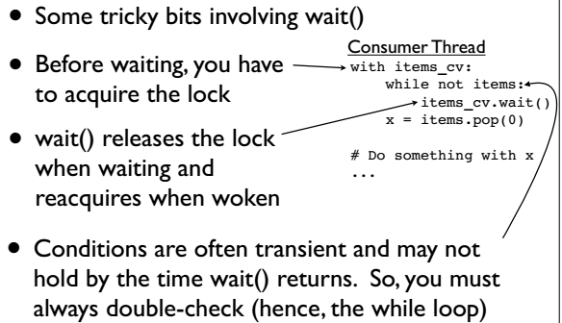
Condition Variables

Slide 23
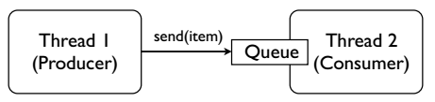
Threads and Queues
Threaded programs are often easier to manage if they can be organized into producer/consumer components connected by queues
Instead of "sharing" data, threads only coordinate by sending data to each other
Think Unix "pipes" if you will...

Slide 24
Threads and Queues
Python has a thread-safe queuing module
Basic operations
from queue import Queue q = Queue([maxsize]) # Create a queue q.put(item) # Put an item on the queue q.get() # Get an item from the queue q.empty() # Check if empty q.full() # Check if full
Usage : You try to strictly adhere to get/put operations. If you do this, you don't need to use other synchronization primitives.

Slide 25
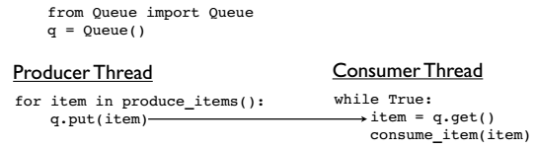
Queue Usage
Most commonly used to set up various forms of producer/consumer problems
Critical point : You don't need locks here

Slide 26
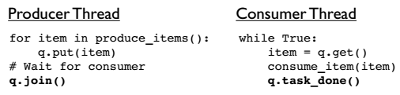
Queue Signaling
Queues also have a signaling mechanism
q.task_done() # Signal that work is done q.join() # Wait for all work to be done
Many Python programmers don't know about this (since it's relatively new)
Used to determine when processing is done

Slide 27
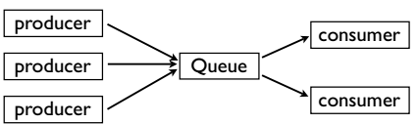
Queue Programming
There are many ways to use queues
You can have as many consumers/producers as you want hooked up to the same queue
In practice, try to keep it simple

Slide 28
Interlude
Working with all of the synchronization primitives is a lot trickier than it looks
There are a lot of nasty corner cases and horrible things that can go wrong
Bad performance, deadlock, livelock, starvation, bizarre CPU scheduling, etc...
All are valid reasons to not use threads

Slide 29
Why Threads?
Threads are still useful for I/O-bound apps
For example : A network server that needs to maintain several thousand long-lived TCP connections, but is not doing tons of heavy CPU processing
Here, you're really only limited by the host operating system's ability to manage and schedule a lot of threads
Most systems don't have much of a problem--even with thousands of threads

